Slide 1
A DATA MINING FRAMEWORK FOR
SOCIAL GRAPH GENERATION & ANALYSIS
Submitted by: Supervisor:
Danish Kumar Dr. Muhammad Abulaish
SAU/CS(M)/2016/14

Slide 2
OUTLINE
Data Mining & Modelling
Social Graphs & Analysis
Applications of Graph Analysis
Problem Definition
Social Graph Clustering
Conversion of Social Graph to similarity graph
Multi-attributed graph distance measure Algorithm
Multi-attributed graph similarity algorithm
Markov Clustering
Iris data set clustering
Tweet dataset (Real dataset) Clustering

Slide 3
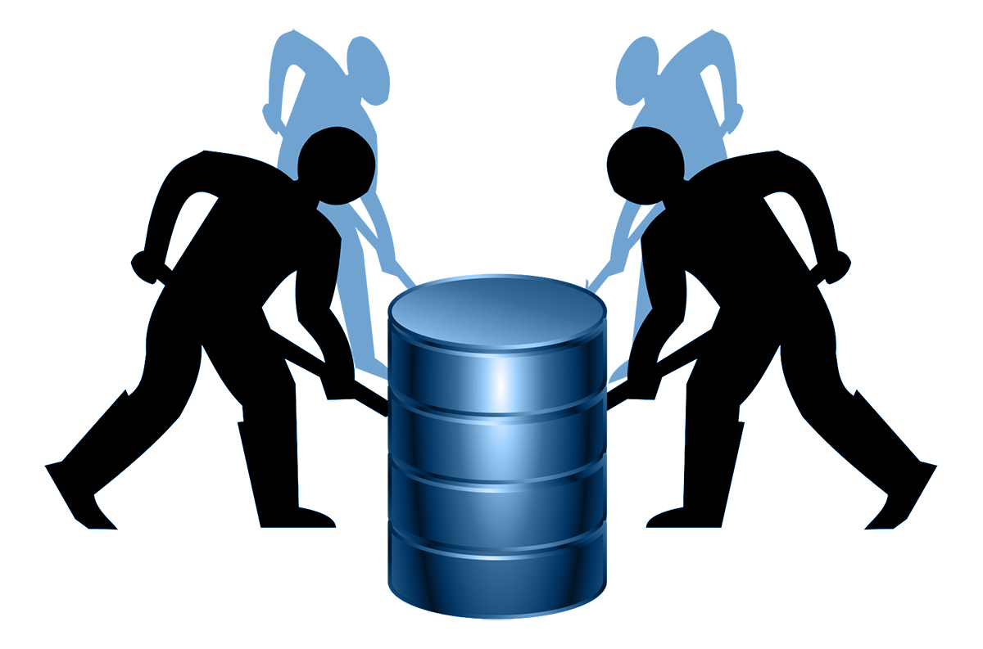
DATA MINING
The process of discovering insightful, interesting, and novel patterns, as well as descriptive, understandable, and predictive models from large-scale data.
Data Mining techniques:
Association
Classification
Clustering
Predication

Slide 4
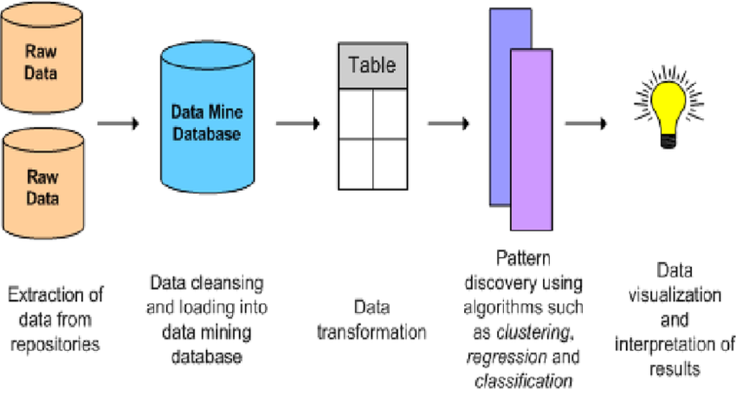
DATA MINING
We need information but we have a huge amount of data flooding around companies, organizations even individuals.
Because of the amount of data is so enormous that human cannot process it fast enough to get the information out of it at the real-time, so Data Mining techniques are used to do this task in real-time

Slide 5
DATA MINING
The Data is critical for company’s growth. It contains knowledge that could lead important decisions that bring business to the next level. Example:
Clustering the social network users based on some criteria
Or clustering the topics in social media to find trends
It help top executive and systems to make decisions faster based on extracted facts. Example:
As like Facebook make cluster of it users living in specific geography and suggest them mark safe options after an incident.

Slide 6
DATA MODELING
In computer science, data modeling is the process of structuring and organizing data, which is essential for analyzing and processing the data to mine the useful information.
Due to exponential growth of complex data, graph structure has become increasingly important to model various entities and their interactions.
Depending on the complexity of the data, the underlying graph model can be
Simple graph
Directed, undirected weighted or unweighted graph
Complex graph (multi-attributed graph)

Slide 7
SOCIAL GRAPH
A representation of the interconnection of relationships in an online social network.
Social networks are Internet-based applications which form the social relations between people.
These relationships are based on the:
same career interests
activities, backgrounds or some real-life connections
They provide services such as e-mail, instant messaging, online forums for discussions, photo/video sharing and weblogging like diary entries online.
Eg: Facebook,Instagram,Twitter,Google+

Slide 8
GRAPH DATA ANALYSIS
Graph analysis – a methodology in data analytics
To retrieve fined-grained relationships between data entities
Can be used with other approaches, e.g. Machine learning
Four widely used types of graph analytics includes
Path analysis,
Connectivity analysis,
Community analysis and
Centrality analysis

Slide 9
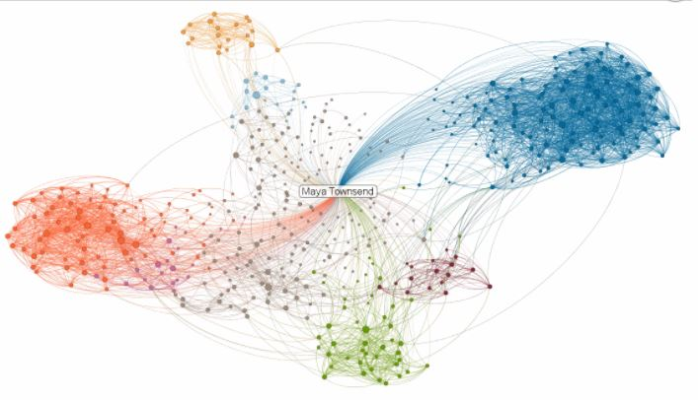
APPLICATION OF GRAPH ANALYSIS
Social network analysis and mining
Pattern mining
Clustering
Frequent sub-graph mining

Slide 10
PROBLEM DEFINITION
One of the important task related to graph data analysis is to decompose large graph into multiple cohesive sub-graphs in order to identify the communities in the graph.
Social graph is also a type of multi-attributed graph, where vertices have multiple attributes and there are multiple weighted edges between a pair of vertices.
The goal is to generate and analyze the social graph modeled as a multi-attributed graph.

Slide 11
MULTI-ATTRIBUTED GRAPH / SOCIAL GRAPH
Fazil
25 y.o
Male
16 Grade
Delhi
Enginner
Majid
24 y.o
Male
18 Grade
Mazar
Engineer
Yalda
40 y.o
Female
18 Grade
Engineer
Dubai
John
25 y.o
Male
20 Grade
London
Saleem
26 y.o
Male
18 Grade
Doctor
Kabul
Habib
25 y.o
Male
18 Grade
Bussiness man
London
Lena
25 y.o
Female
18 Grade
Doctor
Kabul
Prakash
25 y.o
Male
18 Grade
London
Engineer
David
33 y.o
Male
16 Grade
Engineer
Dubai
Blue Edge signify Friendshp
Red Edge signify
work in same place

Slide 12
SOCIAL GRAPH CLUSTERING
Since a social graph is a multi-attributed graph, we can not use the traditional graph clustering algorithms directly for clustering.
As like MCL (Markov Clustering), Markov clustering has (nk) complexity, where n is the number of node and k is the maximum degree in graph is use for graph clustering while considering only structure of the graph.
For clustering the social graph, we use approaches to convert the social graph into a simple graph (similarity graph) base on consideration of attributes and edges value.

Slide 13
CONVERSION OF SOCIAL GRAPH TO SIMILARITY GRAPH
First, we use MAG-Distance algorithm to find difference between the pair of nodes which considers both the nodes and edges value.
MAG-Dist algorithm which reads multi-attributed graph stored in CSV files containing the list of vertex vectors and edge vectors and calculate the distance between each vertex-pair using weighted distance measure which is based on the Euclidean distance norm.

Slide 14
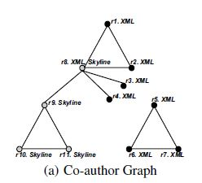
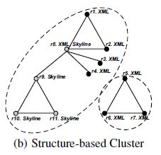
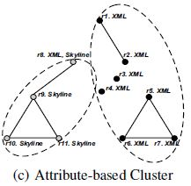
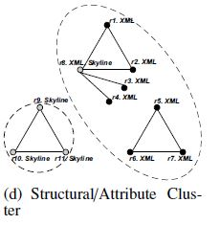

MULTI-ATTRIBUTED GRAPH DISTANCE MEASURE
λ $=\frac{1}{(1+ω\left(u,v\right))γ}$
$ω\left(u,v\right)$= $\sum_{i}^{n}{α_{i}{\text{е}}_{i}(u,v) }$
$∆(u,v)$ = $\sqrt{\text{λ}}$ × $\sqrt{{\sum_{i=1}^{n}{(u_{i}− v_{i})}}^{2}}$

Slide 15
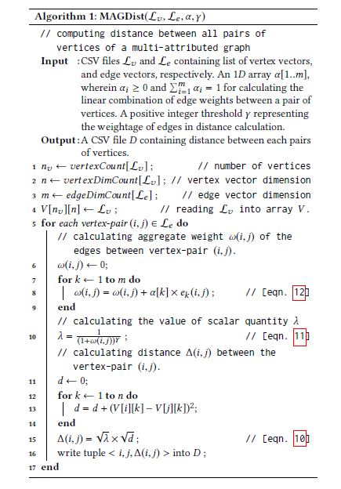
MAG-DIST ALGORITHM

Slide 16
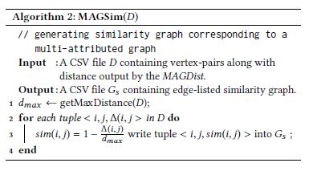
MULTI-ATTRIBUTED GRAPH SIMILARITY ALGORITHM
Second, now we use MAG-Sim algorithm to calculate the similarity graph matrix using the output of MAG-Dist algorithm.
MAG-Sim algorithm use to subtract the normalized distance measures from 1.

Slide 17
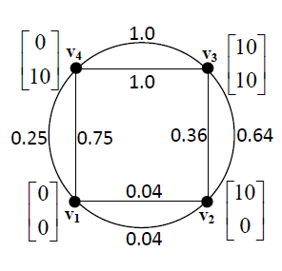
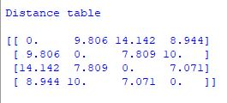
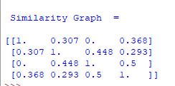

EXAMPLE
D Matrix obtained by the value of $γ$=1
MAG-Dist Output (D)
Input graph
MAG-Sim Output

Slide 18
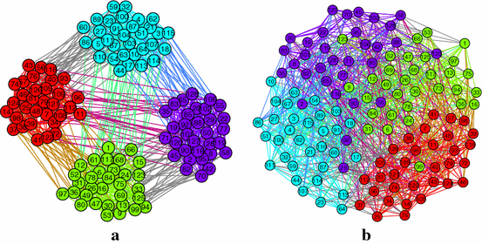
CLUSTERING
The process of organizing objects into groups whose members are similar in some way or close to each other.
A cluster is therefore a collection of objects which are ‘similar’ between each other and ‘dissimilar’ to the objects belonging to another cluster.
It is an Unsupervised Learning method.
Graph clustering intuition
Densely-connected nodes should be in one cluster
Sparsely-connected nodes should be in different clusters

Slide 19
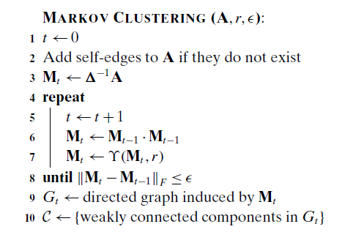
MARKOV CLUSTERING ALGORITHM
A fast and scalable unsupervised cluster algorithm for graphs.
Clustering method based on simulating a random walk on a weighted graph.
A random walk in graph that visits a dense cluster will likely not leave the cluster until many of its vertices have been visited.

Slide 20
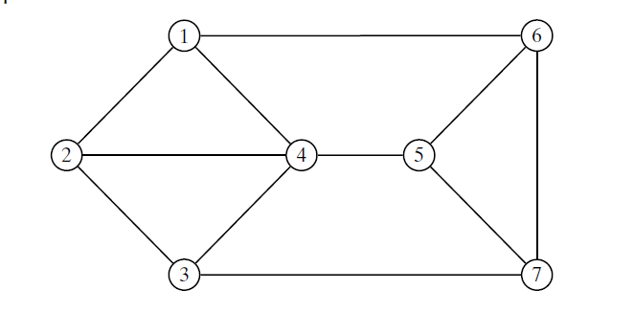
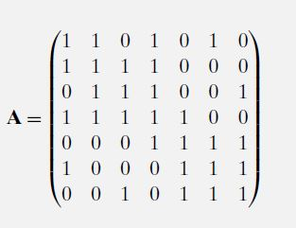
EXAMPLE
Input Graph

Slide 21
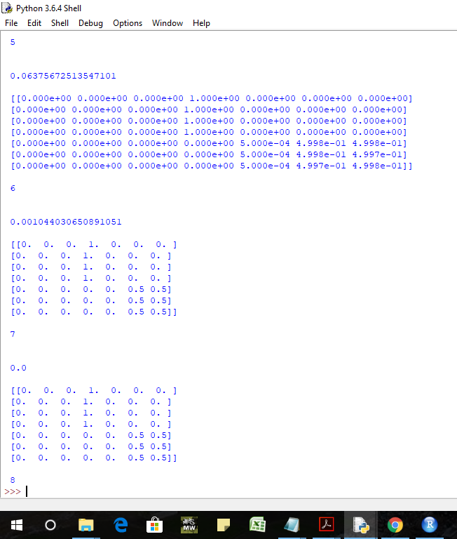
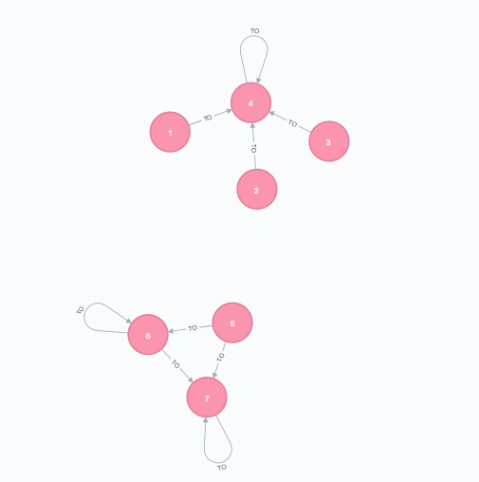
EXAMPLE…
EXAMPLE
Itreations
Result

Slide 22
IRIS DATASET CLUSTERING
Data explain four different characteristics of 3 spices of Iris flower:
Sepal length
Sepal width
Petal length
Petal width
Where Iris dataset contain 50 observations of each spice and total instance of Iris dataset is 150.

Slide 23
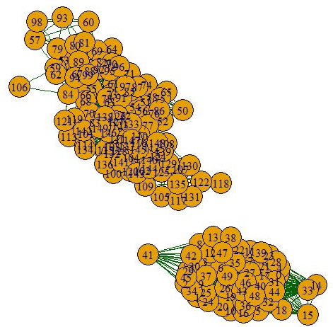
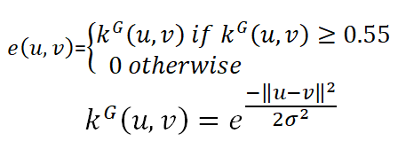

IRIS DATASET GRAPH GENERATION
Iris data simples are represented by four-dimensional space $ℝ^{4}$
Gaussian Kernel is used to generate edges between instant pairs

Slide 24
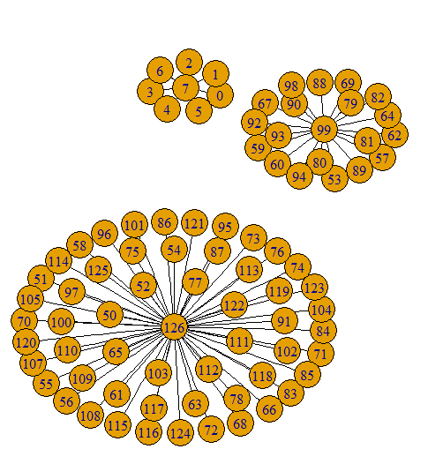
MCL RESULT

Slide 25
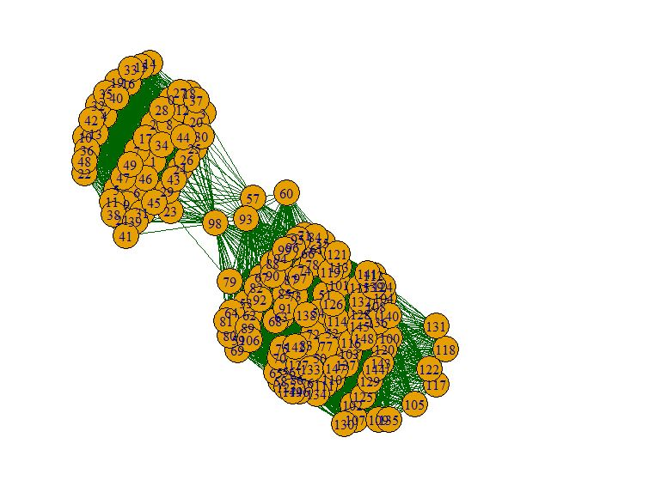
IRIS DATA GRAPH MODELLING USING MAG-DIST & MAG-SIM GENERATION

Slide 26
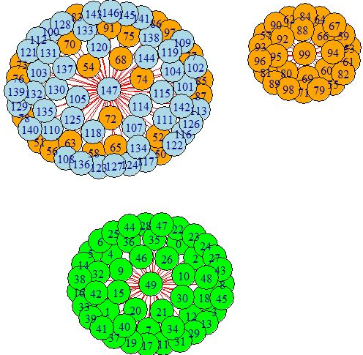
MCL RESULT
Now MCL result high quality clustering

Slide 27
TWEET CLUSTERING (REAL DATASET)
Put tweets in same cluster which discuses the same event or topic. We use the above presented approaches to cluster the tweets.
Steps for tweets clustering:
Tweet crawling
Preprocessing
Feature extraction
Graph generation (Node formation, Edges formation)
Conversion of social graph to a similarity graph (MAG-Dist & MAG-Sim)
Apply MCL on similarity graph

Slide 28
SOCIAL GRAPH GENERATION
To Generate a social graph for tweets dataset.
Form the nodes
Form the edges
For nodes generation:
we select top words from the tweet dataset
We form binary vector representation of top words in each tweet based on its presence in the top word list.
Then each tweets present a vertex in the graph.
An edge between vertex pairs :
Is presented by the number of overlapped hashtags

Slide 29
FEATURE EXTRACTION
Before feature extraction we should preprocess the tweets dataset.
Preprocessing:
Data pre-processing is an important step in the data mining , which increase the efficiency of methods.
So, we used NLTK (natural language tool kit) library in python to preprocess tweets as follow:
URL removal
Stop words removal
Punctuation removal
Stemming

Slide 30
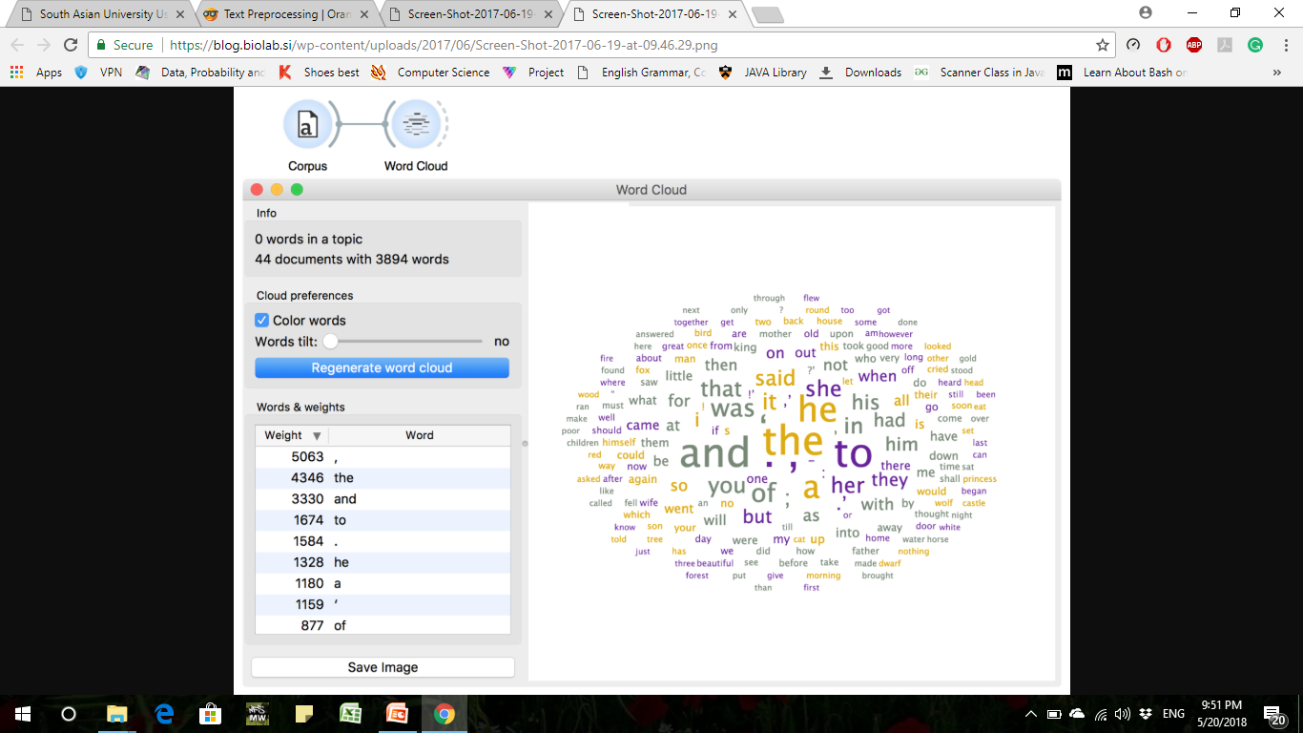
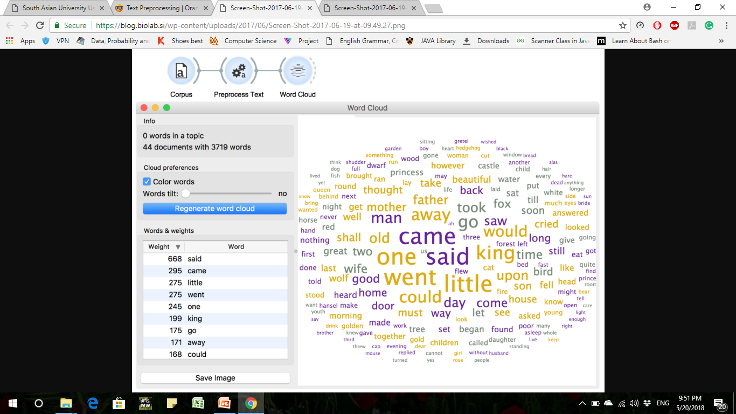
FEATURE EXTRACTION…
Advantage of pre-processing the data

Slide 31

FEATURE EXTRACTION…
We use Tf-Idf score to select terms for a list of Top Words.
After preprocessing of tweets, to find Tf-Idf one should consider the following steps :
Tokenization
Create vocabulary of terms
TF (Term Frequency)
IDF (Inverse Document frequency)
TF*IDF

Slide 32
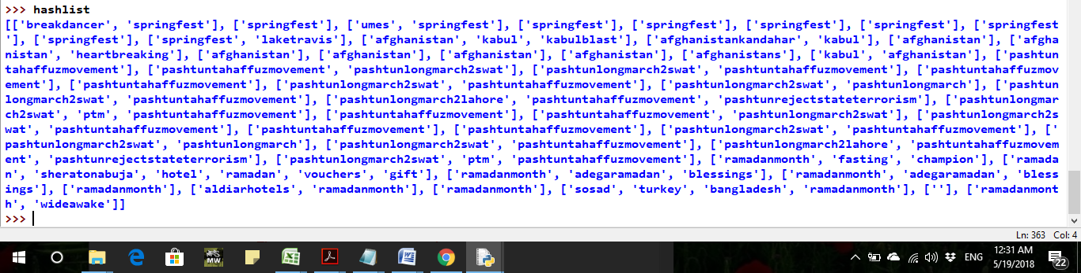
FEATURE EXTRACTION…
Hashtags mostly contain the most important words for detecting the subjects of a tweet.
We extract hashtag words from each tweet separately, and create a separate hashtags list for each tweet.
Now using Top word list and hashtag we generate the social graph.

Slide 33
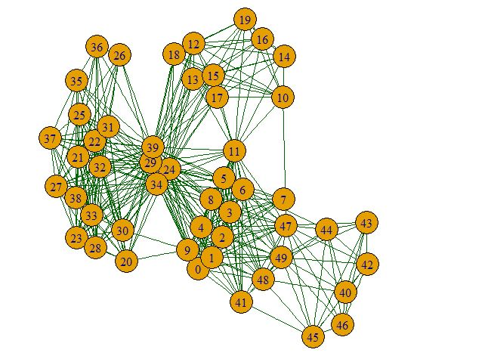
MAG-DIST & MAG-SIM ALGORITHM RESULT

Slide 34
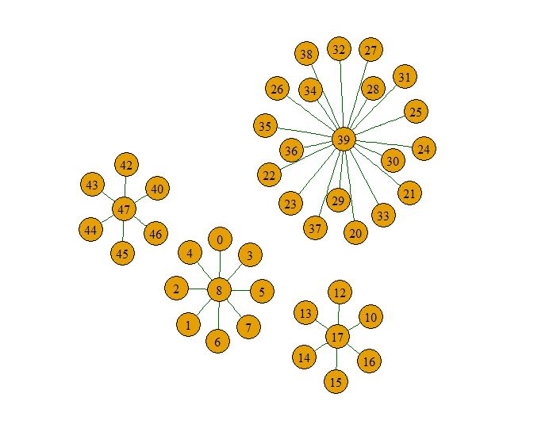
MCL RESULT

Slide 35
RESULTS
 | Cluster 1 | Cluster 2 | Cluster 3 | Total
Setosa | 8 | 0 | 0 | 8
Versicolor | 0 | 20 | 30 | 50
Virginica | 0 | 0 | 27 | 27
Cluster 1 |  | Cluster 2 |  | Cluster 3 |  | Total
setosa | 50 | Setosa | 0 | Setosa | 0 | 50
Versicolor | 0 | Versicolor | 27 | Versicolor | 23 | 50
virginica | 0 | Virginica | 0 | Virginica | 48 | 48
Clusters | Efficiency rate
C1 | 0.9
C2 | 0.7
C3 | 1
C4 | 0.7
average | 0.825
Efficiency for tweet clustering

Slide 36
CONCLUSION &
FUTURE WORKS
The efficiency of approach depends on the data modelling and social graph generation.
For quality clustering, it is important to select suitable and important features from data to generate the graph model.
Real-life data that can be modeled as Multi-attributed Graph.
Citation Network
Social Network Data
Market Analysis, etc.

Slide 37
REFERENCES
Campbell, William M., Charlie K. Dagli, and Clifford J. Weinstein. "Social network analysis with content and graphs." Lincoln Laboratory Journal 20.1 (2013): 61-81.
Basu-Roy, Senjuti, Tina Eliassi-Rad, and Spiros Papadimitriou. "Fast and Effective Pattern Matching on Weighted Attributed Graphs." ACM Knowledge Discovery and Data Mining (2013).
Gallagher, Brian. "Matching structure and semantics: A survey on graph-based pattern matching." AAAI FS 6 (2006): 45-53.
Zhou, Yang, Hong Cheng, and Jeffrey Xu Yu. "Graph clustering based on structural/attribute similarities."Proceedings of the VLDB Endowment 2.1 (2009): 718-729.
Agrawal R, Gehrke JE, Gunopulos D, Raghavan P, inventors; International Business Machines Corp, assignee. Automatic subspace clustering of high dimensional data for data mining applications. United States patent US 6,003,029. 1999 Dec 14.
Muhammad Abulaish and Jahiruddin, “A Novel Weighted Distance Measure for Multi-Attributed Graph”, In Proceedings of the 10th Annual ACM India Conference (COMPUTE), Bhopal, India, Nov. 16-18, 2017.
Mohammed J. Zaki and Wagner Meira Jr. 2014. “Data Mining and Analysis: Fundamental Concepts and Algorithms”. Cambridge University Press, New York, USA.

Slide 38
REFERENCES
Bhat, Sajid Yousuf, and Muhammad Abulaish. "A Unified Framework for Community Structure Analysis in Dynamic Social Networks." Hybrid Intelligence for Social Networks. Springer, Cham, 2017. 77-97.
Fazil, Mohd, and Muhammad Abulaish. "Why a socialbot is effective in Twitter? A statistical insight." Communication Systems and Networks (COMSNETS), 2017 9th International Conference on. IEEE, 2017.
Ng, Raymond T., and Jiawei Han. "E cient and E ective Clustering Methods for Spatial Data Mining." Proceedings of VLDB. 1994.
Schaeffer, Satu Elisa. "Graph clustering." Computer science review 1.1 (2007): 27-64.
Cheng, Jiefeng, et al. "Fast graph pattern matching." Data Engineering, 2008. ICDE 2008. IEEE 24th International Conference on. IEEE, 2008.
Kwak, Haewoon, et al. "What is Twitter, a social network or a news media?." Proceedings of the 19th international conference on World wide web. ACM, 2010.

Slide 39
THANK
YOU!

